Slide 1


ONLINE HOME SERVICES
Presented By : -
GROUP NO :- G24
Kanchanmala Barwade(223033)
Kamaksha Puri(223160)

Slide 2
INTRODUCTION
Generally in houses we require so many different services like painting houses, housekeeping, gardening etc. For all above services previously we need to go to service provider and they will charge according to their own standard and in that business there is no transparency and no customer satisfaction. For this our Online Home Services is the best solution.
Online Home Services (OHS) is intended to provide solutions for customer using a single path named Internet. It will allow the admin to share the details that are required to customer and the customer can receive it from the same platform. An administrator plays an important role by making a service available for the customer and maintain the records.

Slide 3
MODULES
In our project 2 different modules are as follows:
Customer Module
Admin Module

Slide 4
MODULES ….
Customer Module contains :
Register
Login
View Services
Place Order
View Order
Update Profile

Slide 5
MODULES ……
Administrative Module contains :
Manage Services
Manage Employee
Manage Order
View Feedback

Slide 6
Scope & Purpose
Purpose :
Access to variety of home services through one click
Fast and effective services
Budget Friendly
One stop destination for home services

Slide 7
Scope :
Major goals to be accomplished:
Reach to maximum users and get them used to application as there are many ongoing problems with the home services.
As everything in the world is taking one step forward towards the technology there is need to make people get used to these services and make the application simple so that it would be useful for any person.
Make the project ready on platform for users as early as possible.
Once it reaches audience, services should be increased to solve minor to minor problems.

Slide 8
PROPOSED SYSTEM
Product functionality:
Online Home Services provides the features for admin and customer. It includes several functionalities describes as below:
Service Management:
It provides facility to add, update, delete and view the services. Admin can view their details also update it if that particular services are pending or completed.
Employee Management:
The admin can add, update, delete and view the employee and there status.
Service Order:
Customer can place the service order on the basis of their requirement, view status of service order.

Slide 9
WEB PAGES
Home Page
Login Page
Register Page
About and Contact us Page
Feedback Page
Customer Page
Order Page
Profile Page
Admin Page
Manage Services
Manage Employee
View & Manage Orders
View Feedback

Slide 10
UML Diagrams

Slide 11
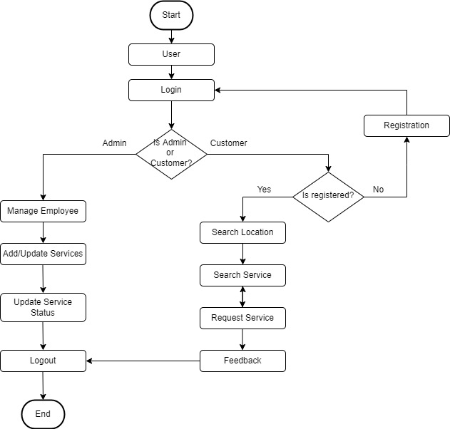
Flow DIAGRAM

Slide 12
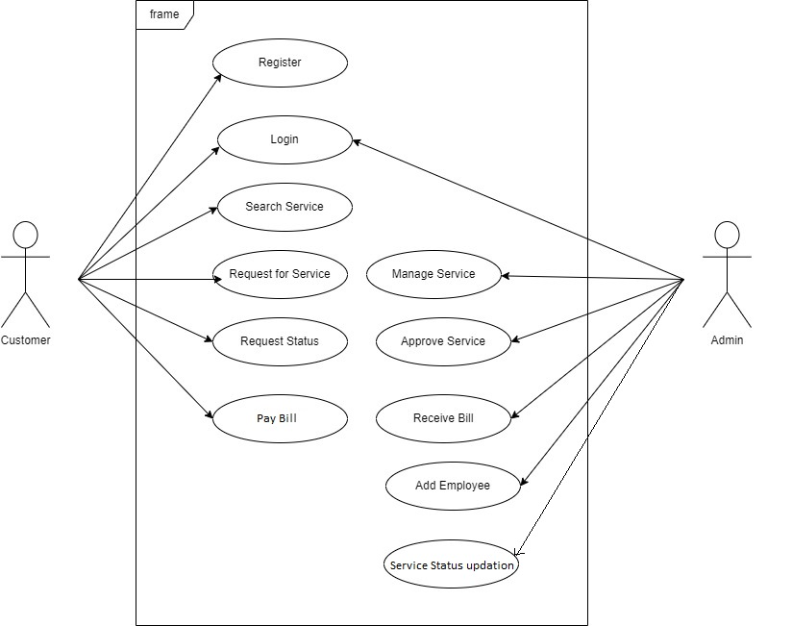
USE CASE DIAGRAM
Use Case Diagram

Slide 13
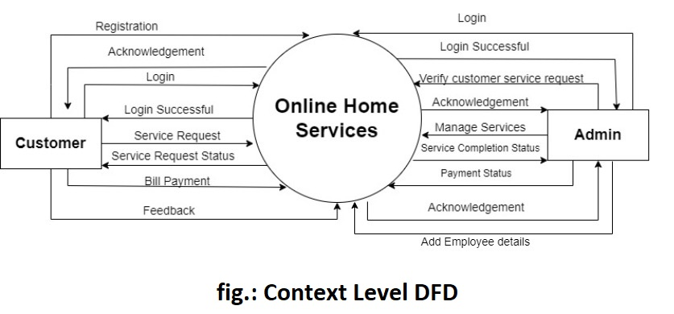
Data Flow Diagram

Slide 14
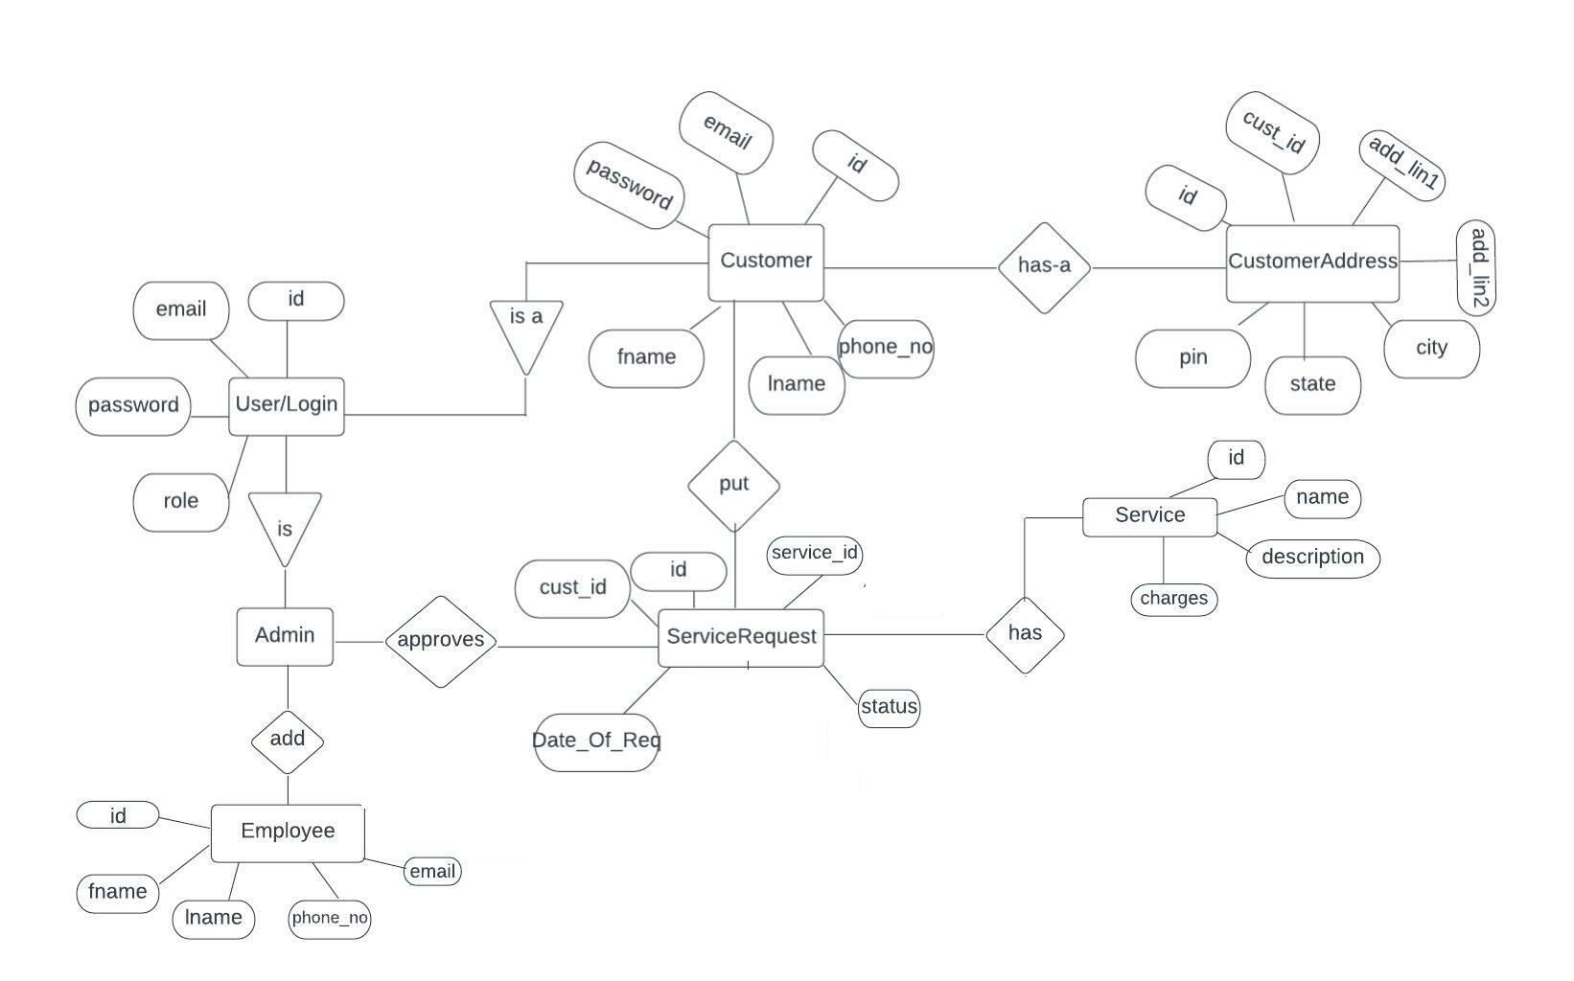
E-R DIAGRAM

Slide 15
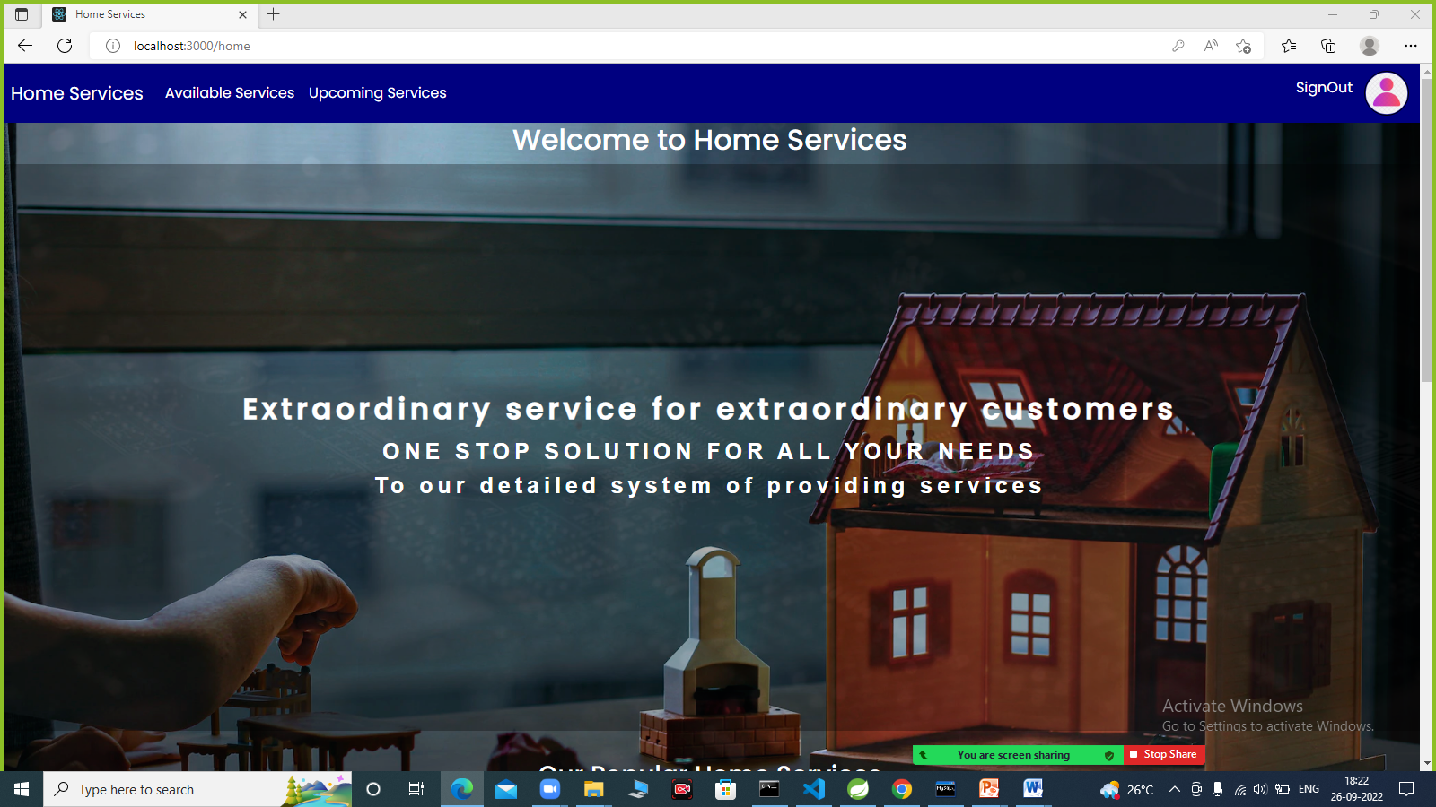
1. Home page

Slide 16
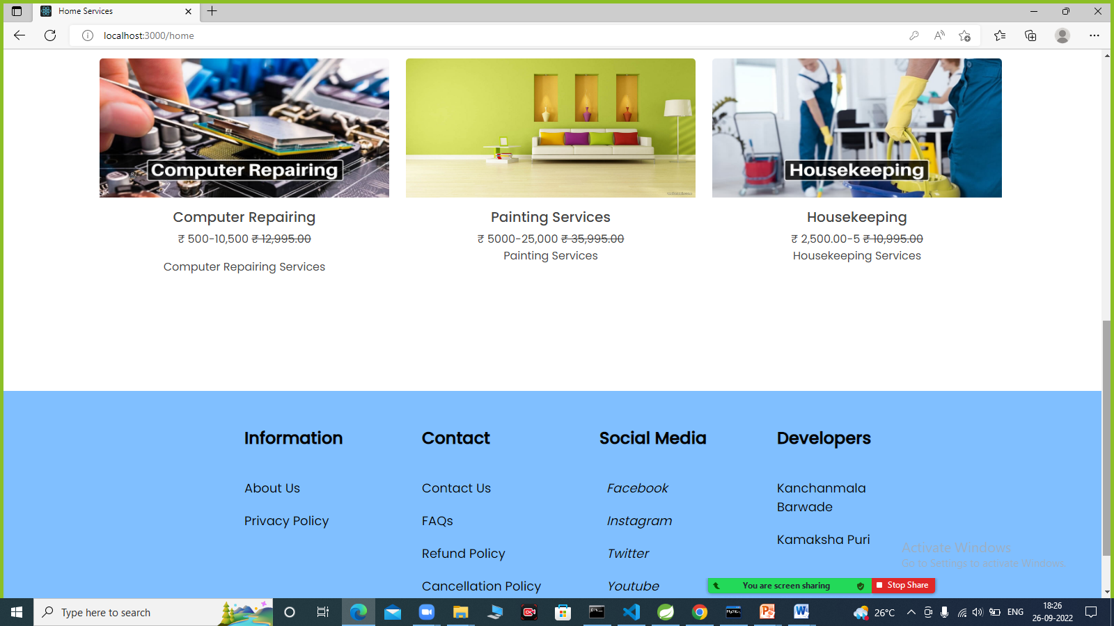
2. Home Page

Slide 17
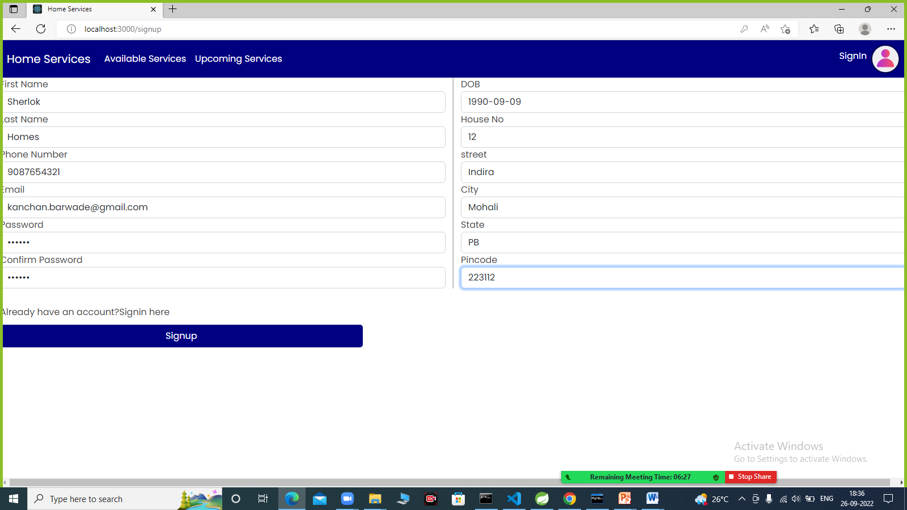
3. Registration Page

Slide 18
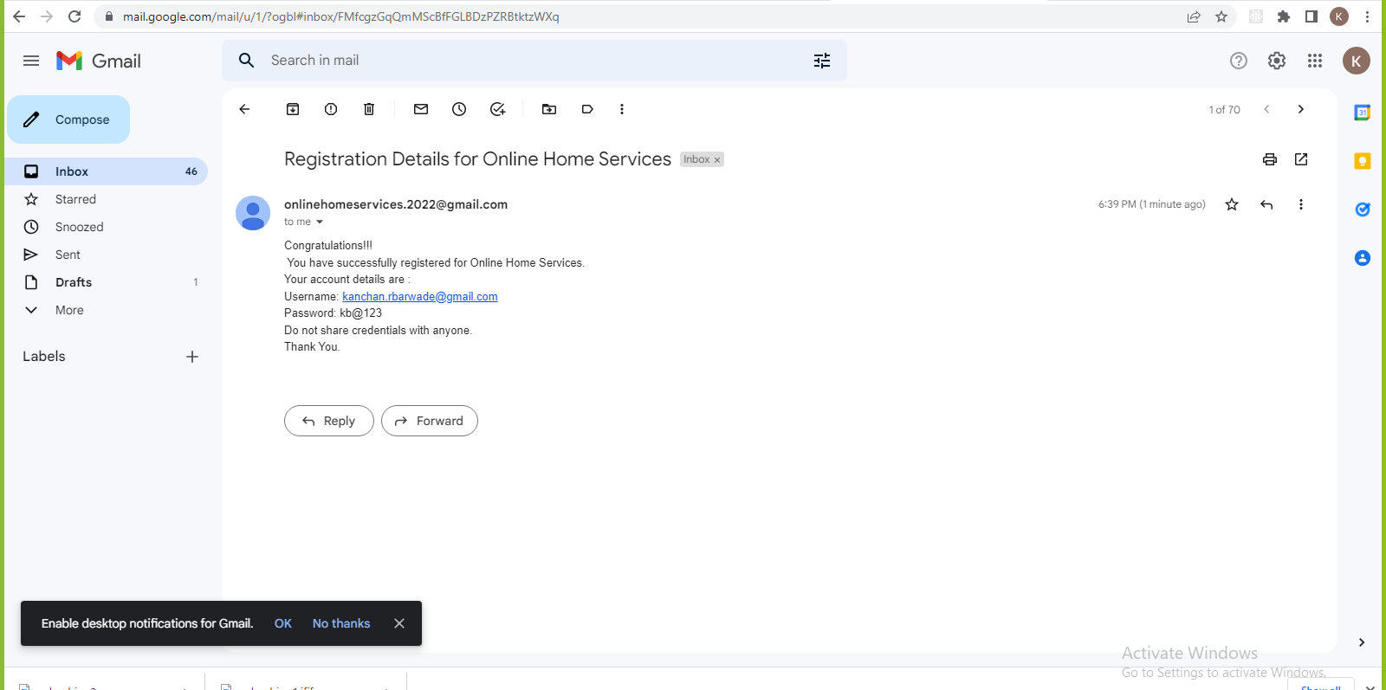
Customer Registration Email confirmation

Slide 19
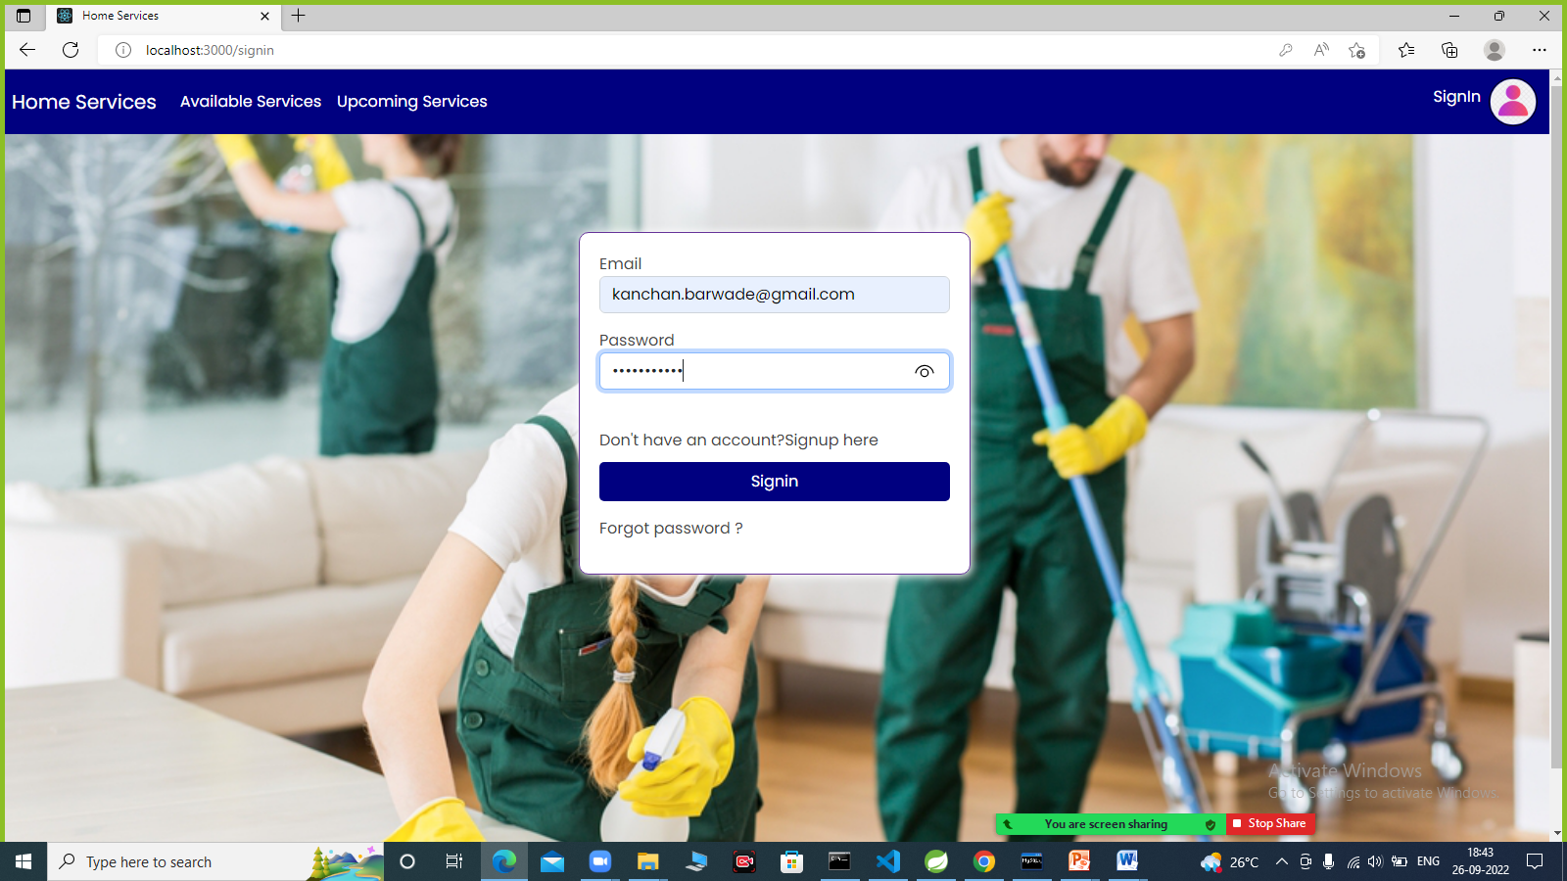
5. Customer Login

Slide 20
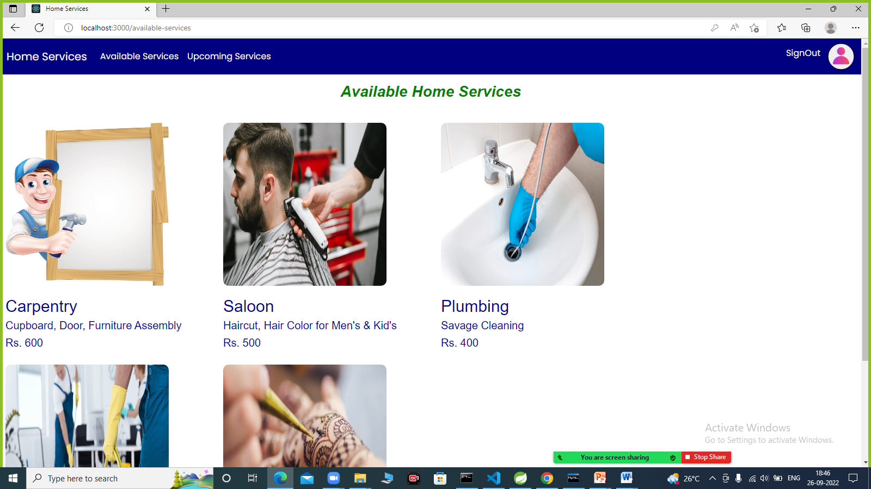
7. Available Services

Slide 21
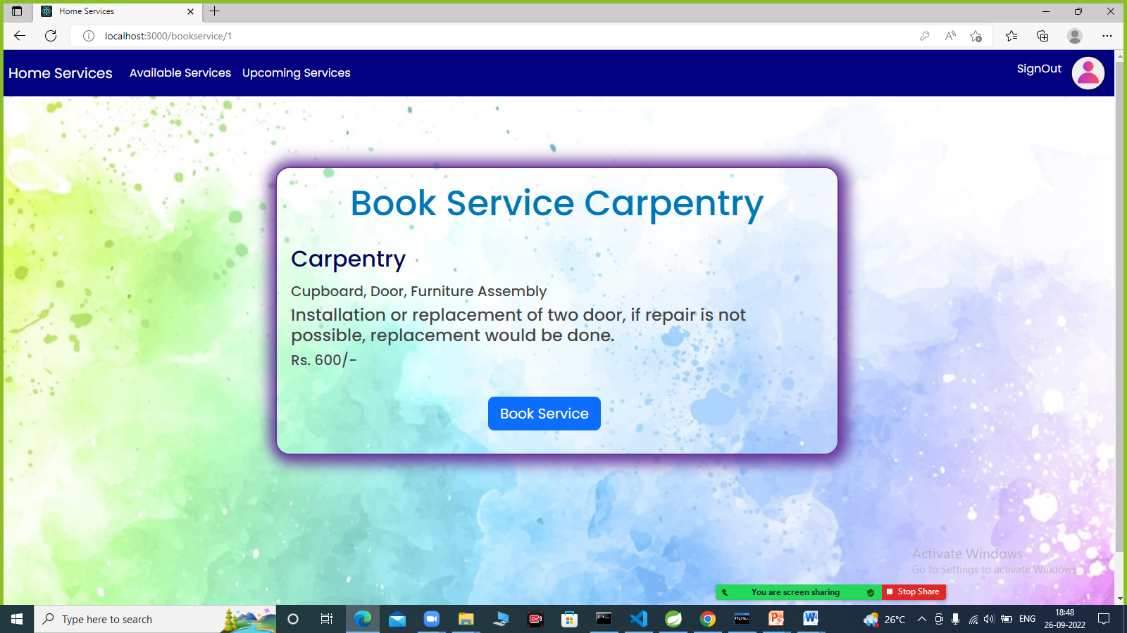
8. Book Service

Slide 22
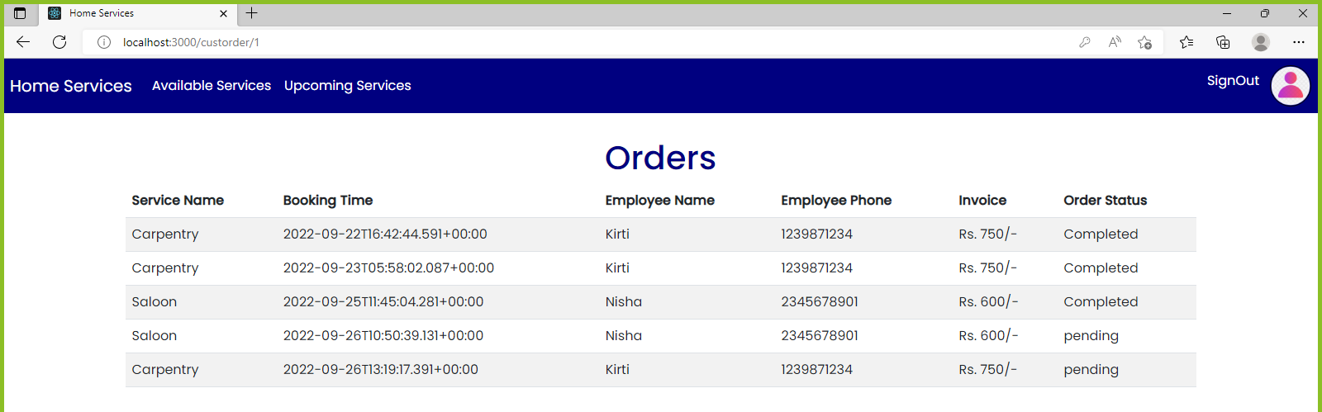
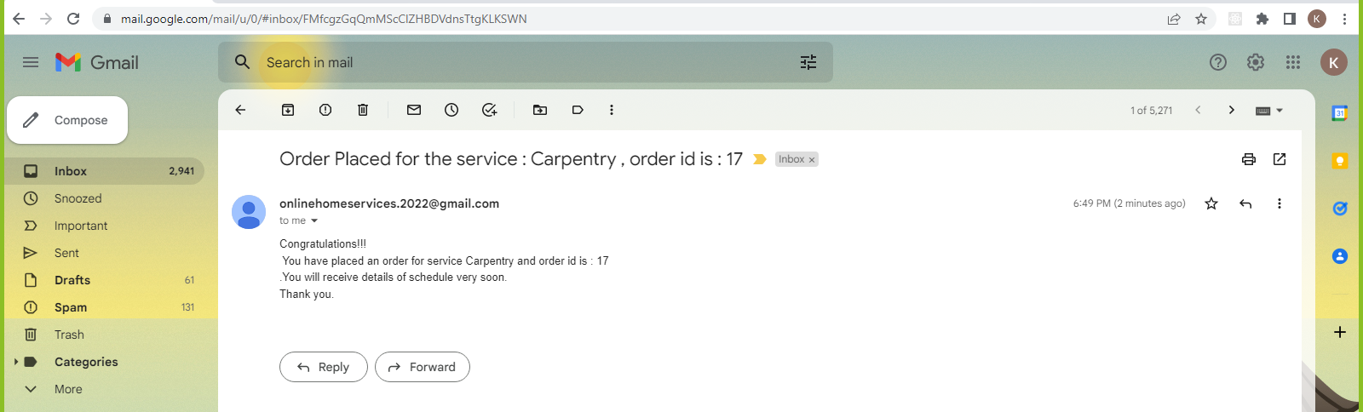
9. Customer orders and confirmation email

Slide 23
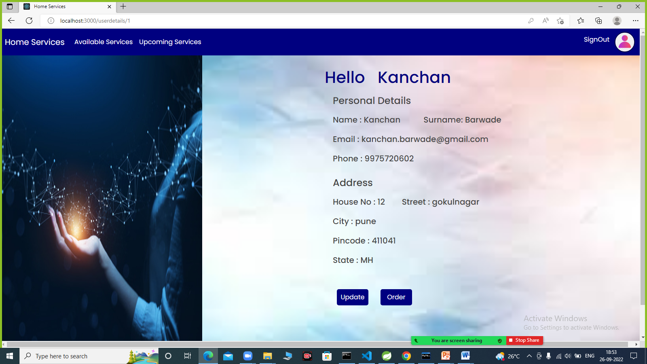
10. Customer Profile

Slide 24
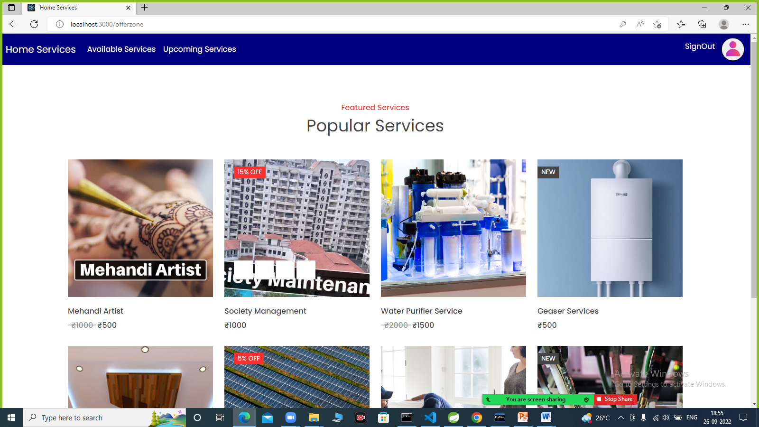
11. Upcoming Services

Slide 25
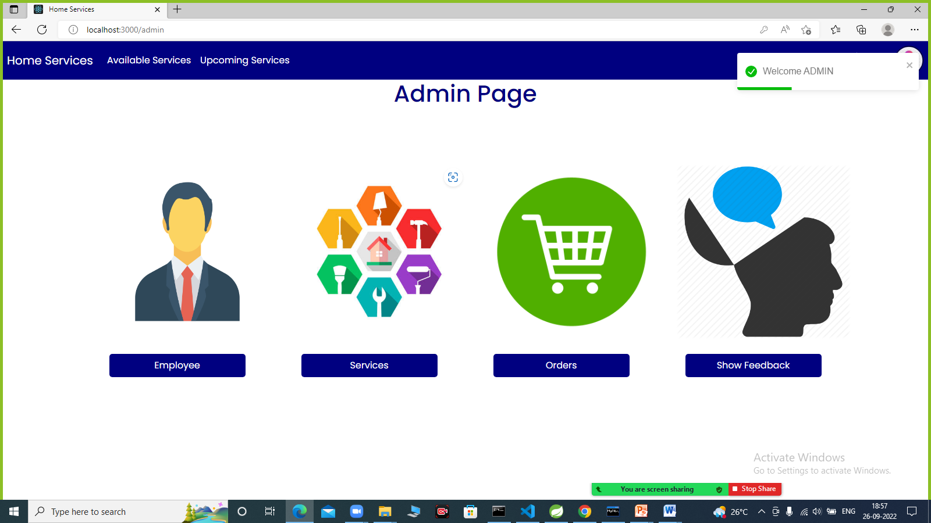
12. Admin Home Page

Slide 26
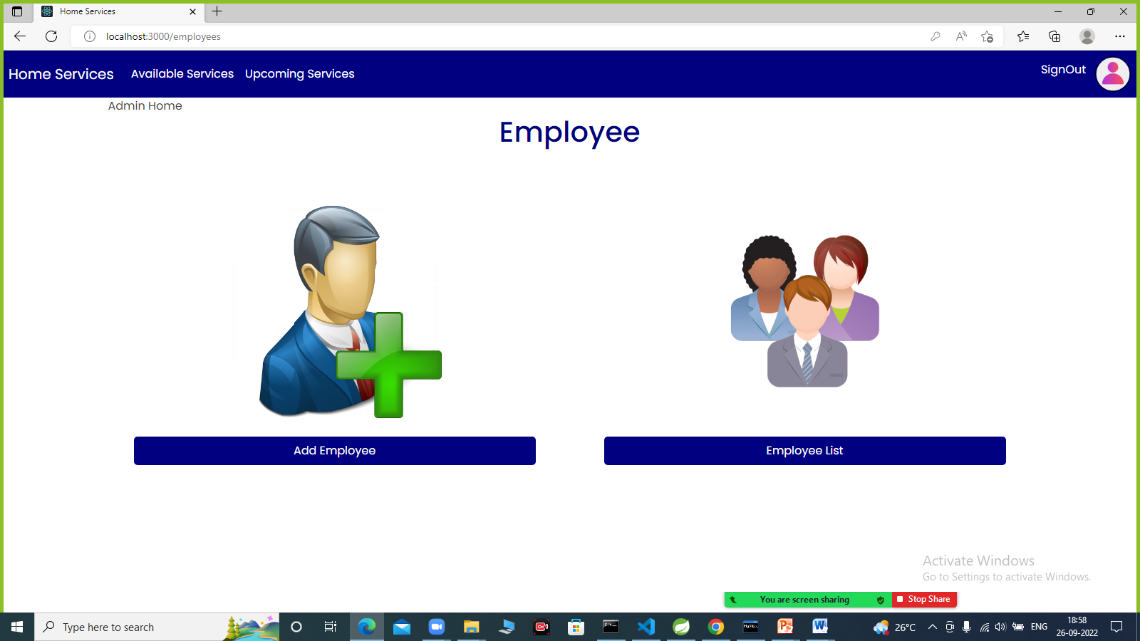
13. Employee

Slide 27
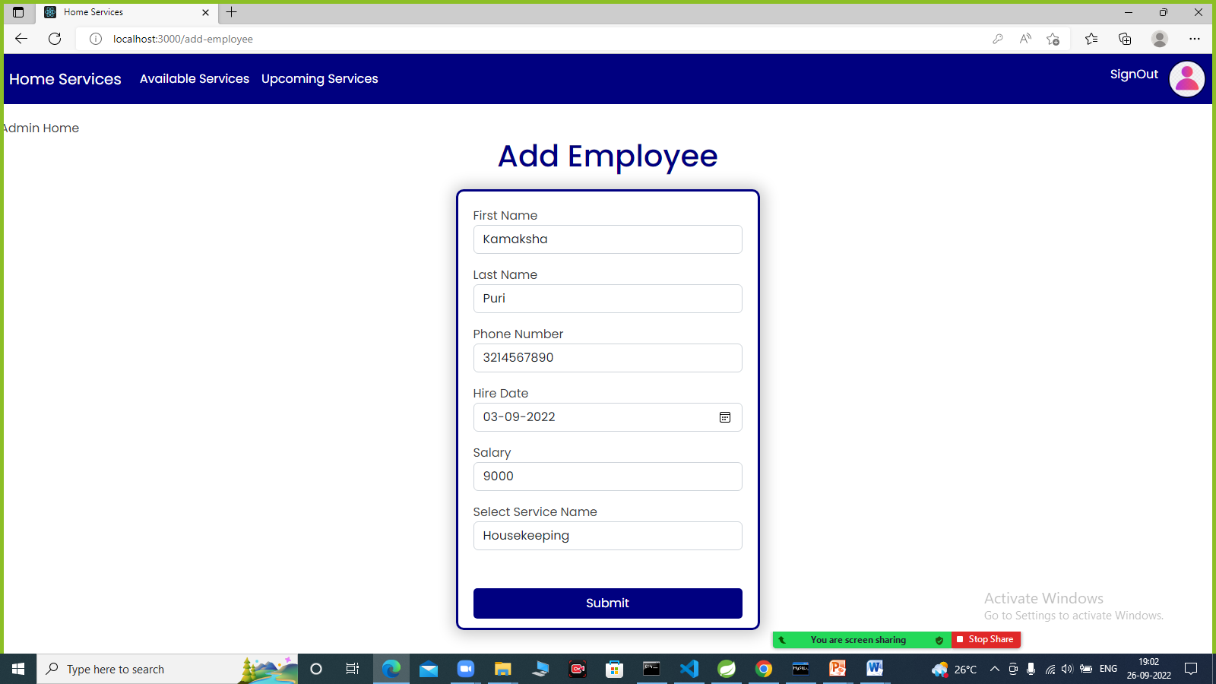
14. Add Employee

Slide 28
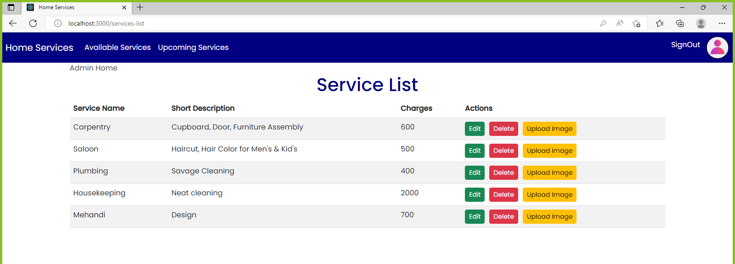
15. Service List

Slide 29
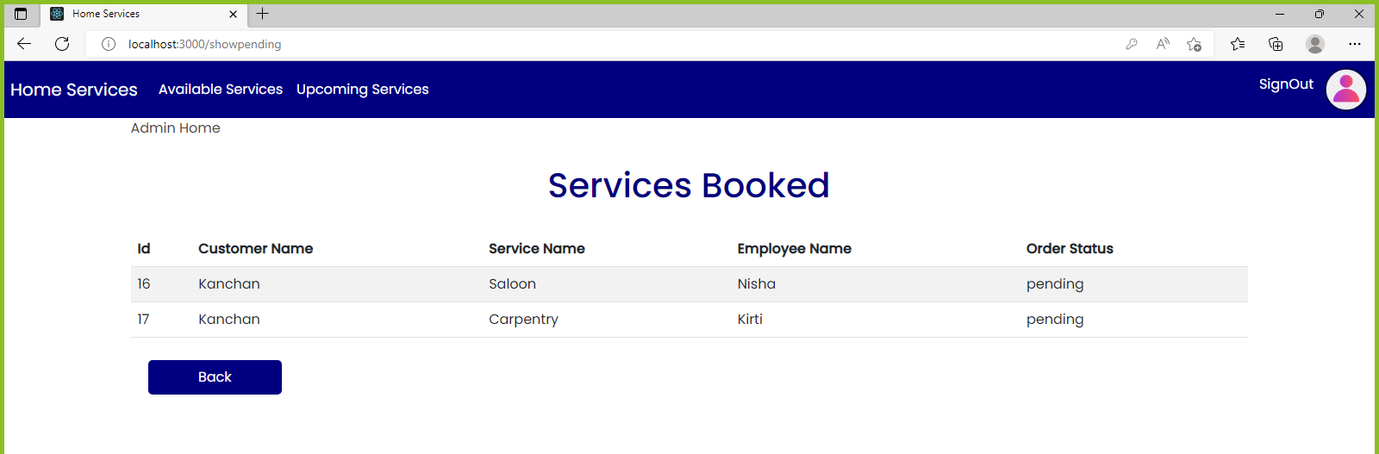
15. Pending Services

Slide 30
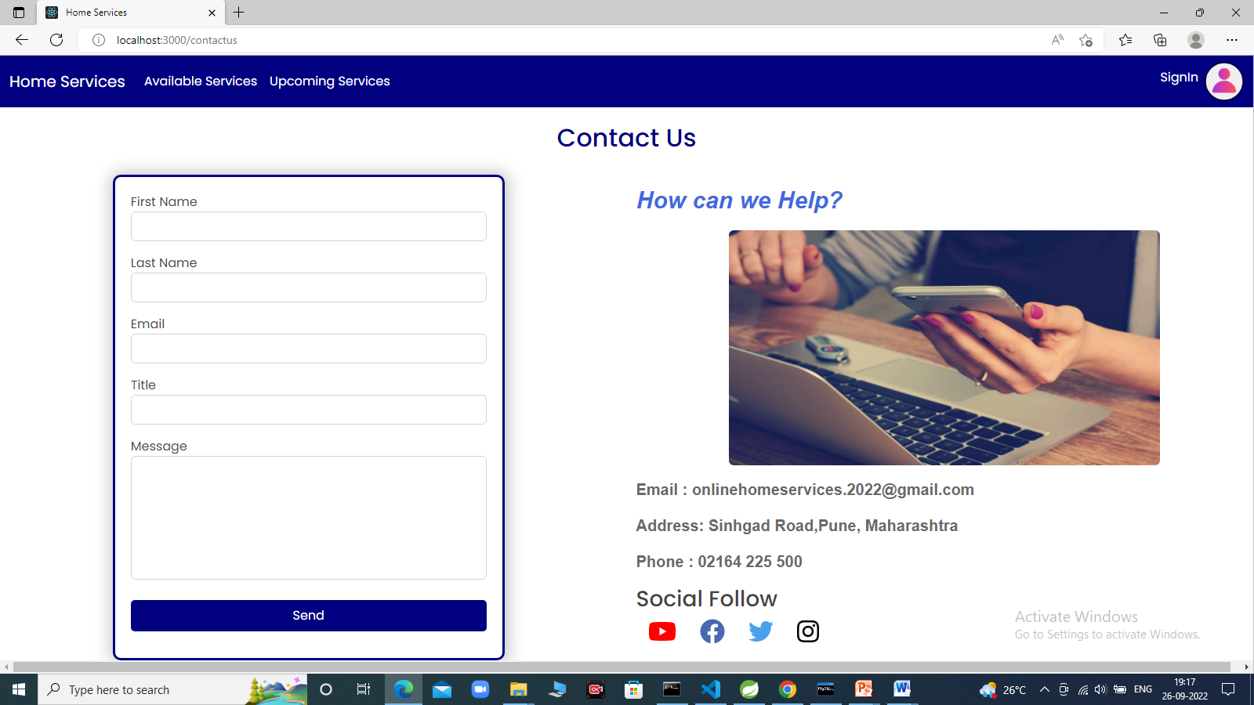
16. Contact Us

Slide 31
SPECIFICATIONS
The application will use JavaScript and CSS as main web technologies.
For Communication, HTTP protocols are used.
For Email communication, SMTP Protocol is used.

Slide 32
FUTURE SCOPE
This project can be enhanced further by adding online payment system, authentication by OTP, for the user to reduce the extra work of the admin. The software is flexible enough to be modified and implemented as per future requirements. We have tried our best to present this free and user–friendly website to customers. Message alerts for various happenings in the application can be added to the system so that users do not miss the updates and happenings of the service request.

Slide 33
CONCLUSION
Online Home Services puts forth the actual working of a home services. Administration, management, employee management, customer management, etc. are the key features of our project. User can access services and functionalities from the online home service anywhere and anytime for their own comfort.

Slide 34
REFERENCES
https://bootstrapmade.com/
https://www.youtube.com/watch?v=qk8nJmIRbxk
https://www.youtube.com/watch?v=l0J-Edn76js&ab_channel=LearnCodeWithDurgesh
https://reactjs.org/docs/

Slide 35
Thank you

